Slide 1

Business Model Canvas
Learn the concepts
Plan faster
How is your business connected to people and money
Rapid Business Planning
Instructor: Brent Whistler
Book me: https://bookme.buildrunkit.com
Try BuildRunKit: https://www.buildrunkit.com
© 2026 Bootstrap Factory LLC (BuildRunKit). Except where otherwise noted, this document and the original contents contained within are licensed under the Creative Commons Attribution-ShareAlike 4.0 International License. You can learn about your responsibilities under this license here: https://creativecommons.org/licenses/by-sa/4.0

Slide 2
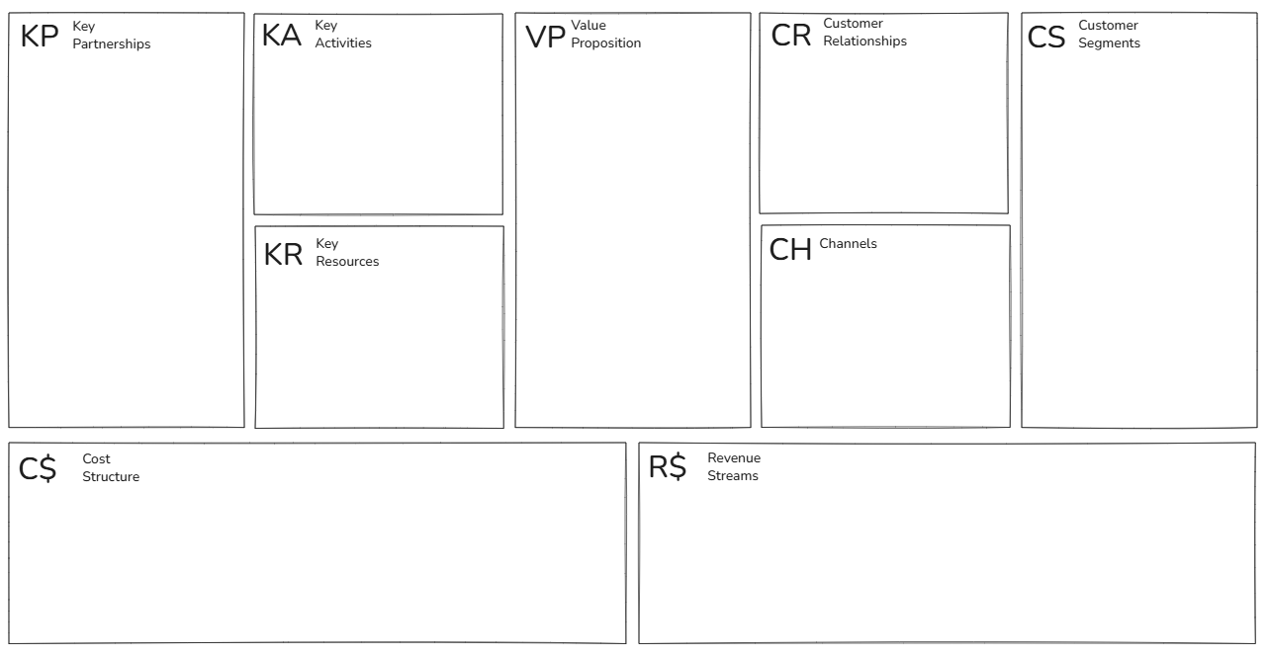
The Business Model Canvas - Designed by Strategyzer AG (strategyzer.com). This work is licensed under the Creative Commons Attribution-ShareAlike 3.0 Unported License. To view a copy of this license, visit http://creativecommons.org/licenses/by-sa/3.0/

Slide 3
AirBnb Example
Minimise risks
Deliver consistency (guest experience)
Remove frictions (guest/host)
Grow network effects
More guests/hosts
New offerings
Technology
VP to guests:
Choice & variety
Higher value
Authentic stays
Local experiences
VP to hosts:
Income generation
Ease of getting started
Good, screened guests
Management tools
Extensive resources
VP to biz travellers:
Amenities
Home feeling
VP to all:
Risk minimisation
Ease of transactions
To hosts & guests:
Safety/security
Support
Issues managem.
To communities:
Good neighbour
Good citizen
Rental hosts
Superhosts
Experiences hosts
Large landlords
Tourism partners
Communities
Biz travel managers
Commercial partners
Insurances
Investors
Lobbyists
Associates
Hosts:
Maximisers
Opportunity seekers
Guests:
Traditional geo-demo
Higher(er) education
Higher(er) income
30-49 year-old
Leisure (single v family) matching, improving VP, trends, etc
Microsegments:
For various purposes, e.g. optimised ranking,
To all:
Responsible hosting
Tech partners:
Inventory integration
Biz travel platforms
And many others
Algorithms
Tech platform
Skilled staff
Playbooks
Acquisitions
Sales, marketing:
Word-of-mouth
Digital marketing
Media coverage
Discounts, promo
Associates
Referrals
Active hosts
Active guests
Brand
Data assets (listings/user data)
Transactions:
App, website
Host/guest
Research & development
Technology platform
New offerings
Sales & marketing
Customer acquisition, discounts, promos, referrals, associates, etc
Insurance
Payment processing
IT infrastructure
General & Admin
G&A staff, legal
Revenue: $8.4b (FY'22)
Commissions on transaction value (incl on service fees)
Urban/suburban/rural (rural highest)
*Guest service fees *host service fees *commission on Airbnb Experiences *FX currency fees *Float *co-branded credit cards etc.. *New Services marketplace
The Business Model Canvas - Designed by Strategyzer AG (strategyzer.com). This work is licensed under the Creative Commons Attribution-ShareAlike 3.0 Unported License. To view a copy of this license, visit http://creativecommons.org/licenses/by-sa/3.0/

Slide 4
Booking.com Example
Hotel/property owners
Major hotel chains
Affiliates
Travel agents
Corporate travel managers
Technology partners
Meta search engines
Lobbyists
Manage network effects
Customer experience
Customer support
Grow the platform
Observe external factors
Enhance technology
Guide customer journey
For travellers:
Cheapest prices
Amount of choice
Reduction of risk
Customer service
Useful app
Useful travel content
For hotels:
Incremental revenue
Ability to react
Global reach
Risk reduction
Additional web traffic
Market intelligence
Hotels:
Commissions
Ease of joining
No booking, no pay
Travellers:
Customer service
Accuracy
Supply Side (Partners)
Independent Hotels & B&Bs
Major Hotel Chains
Alternative Accommodation Hosts
Demand Side (Travellers)
Corporate & Business Travellers
Budget-Conscious Leisure Travellers
"Genius" Program Loyalists
Package Travel Booking Users
Number of hotels
Number of locations
Great content
User data/algorithms
User experience
Global network
Skilled staff
Website (mobile, desktop) App
Partner channels
Ad channels, Search
Communications channels
FY22
Marketing: $6b (33%)
Sales: $2b (11%)
Personnel: $2.5b (15%)
G&A: $0.9b (0.5%)
IT: $0.5b (3%)
D&A: $0.4b (3%)
FY22
Total revenue: $17b
Agency business model: 9b/17b = 53% (cus pays merchant directly)
Merchant business model: 7.2b/7b = 42% (cus pays booking as merchant)
Advertising and other revenues: 0.9b/17b = 6.6%
The Business Model Canvas - Designed by Strategyzer AG (strategyzer.com). This work is licensed under the Creative Commons Attribution-ShareAlike 3.0 Unported License. To view a copy of this license, visit http://creativecommons.org/licenses/by-sa/3.0/

Slide 5
Uber Example
Remove frictions
Improve customer experience
Reduce risks
Increase technical lead
Stimulate participation
Scale existing cities
Expand & grow
Riders:
Custom ride
On-demand
ETA prior to ordering
Lower(er) prices
Convenience
Safety (improving)
Drivers:
Income generation
Work hours: flexible
No boss
App
Safety/support
Eats VP to consumers:
Choice
Discovery
Convenience
Order tracking
Riders:
Safety, security, privacy
Pricing
Drivers:
Opportunity
Fairness
Cities:
"Good citizen"
Drivers
Restaurants
National chains
Tech partners
Cities / communities
Commercial partners
R&D partners
Investors
Lobbyists
Insurance
Other, e.g. car hire, rewards cards
Riders:
Younger, urban, medium-high income
Millennials: long-term
Microsegments:
Purpose of rides, by routes, movement data
Drivers:
Part-time, male, multi-homing (Lyft), college+
By intention: In-betweener, on-the-sider, permanent full-time
Network effects
Active riders / drivers
Data assets
Technology assets
Staff
Local teams
Brand
Word-of-mouth
Media coverage
Marketing
Discounts, promo
Social media, virality
Partnerships
Restaurant pages
Digital assets
Playbooks
Research & development
Technology platform
Sales & marketing
Customer acquisition, discounts, promos, etc
Driver referrals
Insurance
Payment processing
IT infrastructure
General & Admin
G&A staff, legal, professional services
Driver cost base:
Depreciation
Fuel
Financing costs
Licenses (if applicable)
Maintenance, service
Mobility (~28% commission)
Eats (~20% commission)
Freight
All other
Increasing: Advertising
The Business Model Canvas - Designed by Strategyzer AG (strategyzer.com). This work is licensed under the Creative Commons Attribution-ShareAlike 3.0 Unported License. To view a copy of this license, visit http://creativecommons.org/licenses/by-sa/3.0/

Slide 6


Remember Busy Buzz Café?
Let’s go through it for Busy Buzz
What about your business?

Slide 7

Key partnerships
What / Why
Examples (for my coffee cart)
External companies, suppliers, or organizations you need to make your business model work.
Why: show how you reduce risk, optimize your operations, scale quickly, or acquire critical resources
Local Coffee Roasters
Dairy & Alternative Milk Vendors
Commissary Kitchen / Storage Facility
Property Owners & Local Council
Equipment Suppliers & Technicians
Local Bakeries

Slide 8
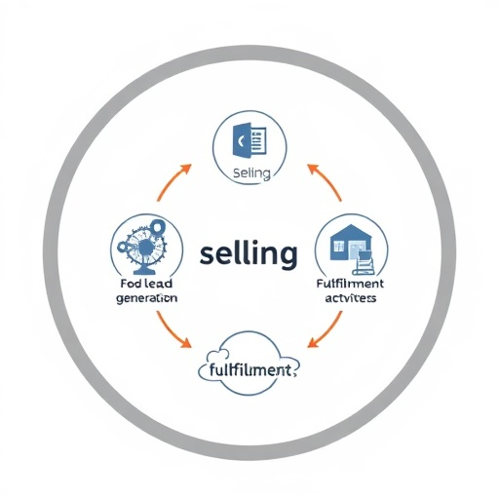
Key Activities
What / Why
Examples
The most important daily actions your company must execute to make its business model work.
Why it's needed: To show exactly where your time, focus, and operational budget must go to deliver your value proposition.
Brewing & serving coffee
Inventory & stock replenishment
Daily cart setup & teardown
Equipment cleaning & maintenance
Point-of-sale & transaction management
Local permit & regulatory compliance

Slide 9

Key Resources
What / Why
Examples
The most important assets (physical, human, intellectual, or financial) required to make your business model work.
Why it's needed: To show what you must own or control to create your value proposition, reach your market, and earn revenue.
Commercial espresso machine & grinder
Mobile coffee cart & trailer
Trained baristas
Initial cash float & operating capital
Brand name, logo, & signage
Opening inventory (Beans, milk, cups)

Slide 10

Value Proposition
What / Why
Examples
The unique bundle of products, services, and distinct benefits that creates value for a specific customer segment.
Why it's needed: It is the core reason why customers choose your business over a competitor; it explicitly solves their problem or satisfies their need.
Segment: Rushed Commuters
  Speed & Convenience (Under 60-second ordering, text-ahead pick-up, prime transit location)
Segment: Specialty Coffee Lovers
  Premium Quality (Single-origin beans, expert barista craft, custom milk alternatives)
Segment: Budget-Conscious Locals
  Affordable Daily Routine (Low price point, high-value sizing, stamp-based loyalty perks)

Slide 11

Customer Relationships
What / Why
Examples
The specific type of interaction and ongoing connection a business establishes and maintains with its customer segments.
Why it's needed: To define how you will acquire new customers, retain existing ones, and boost sales over time.
Personal Assistance (Baristas greeting regulars by name, remembering custom drink orders)
Automated Loyalty Perks (Digital punch cards or SMS rewards to drive repeat visits)
Community Engagement (Active local social media presence, neighborhood chat groups)
Self-Service / Speed (Fast-pass pickup lanes for quick, transactional transactions)

Slide 12
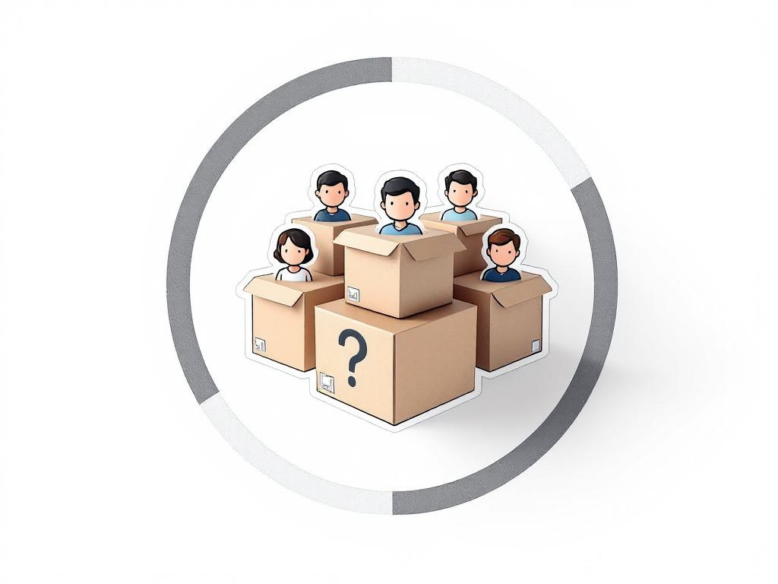
Customer Segments
What / Why
Examples
The distinct groups of people or organizations an enterprise aims to reach and serve.
Why it's needed: A business cannot succeed without customers; grouping them allows you to tailor your product, marketing, and pricing to their specific needs rather than trying to please everyone.
Rushed Commuters
Specialty Coffee Lovers
Budget-Conscious Locals
Remote Workers
Neighborhood Socializers

Slide 13

Channels
What / Why
Examples
The specific touchpoints through which a company communicates with and reaches its customer segments to deliver its value proposition.
Why it's needed: It defines your entire distribution and marketing strategy; it dictates how customers first discover you, buy from you, and receive their product.
Order at Cart (Direct, face-to-face sales point for walk-ups)
Mobile App Purchases (Digital ordering channel for pre-orders and remote sales)
Gift Cards (Pre-paid customer acquisition and word-of-mouth channel)
After-Hours Cart Events (B2B booking channel for private parties, catering, and festivals)

Slide 14
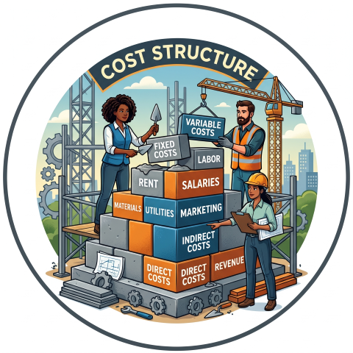
Cost Structure
What / Why
Examples
All the monetary costs and expenses incurred to operate your entire business model.
Why it's needed: To determine whether your business can actually be profitable; it details the financial outlays required to maintain your key activities, resources, and partnerships.
Fixed Costs:
Cart storage & commissary kitchen fees
Permits, licensing, and insurance
Equipment leasing (espresso machine)
Variable Costs:
Raw ingredients (coffee beans, milk, syrups, pastries)
Consumables (cups, lids, napkins, stirrers)
Barista wages & labor
Transaction processing fees (POS/card reader)

Slide 15
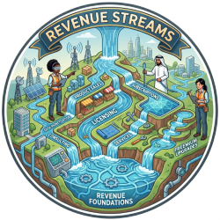
Revenue Streams
What / Why
Examples
The cash a company generates from each customer segment through various pricing mechanisms.
Why it's needed: It represents the financial arteries of your business; it proves that customers are actually willing to pay for your value proposition and shows exactly how the business sustains itself.
Direct Sales (One-time transaction revenue from coffee, tea, and specialty drinks)
Food Upsells (Margin-boosting sales from pastries, snacks, and retail bean bags)
Event Catering (Flat-fee contract revenue for private parties, weddings, and corporate gigs)
Merchandise Sales (Branded travel mugs, t-shirts, and stickers)
Pre-paid Gift Cards (Upfront cash flow driving future transactional sales)
Coffee Subscriptions / Punch Cards (Recurring or locked-in revenue for frequent daily commuters)

Slide 16

Who Cares? What About My Pitch?!
Investor
-What is this?
-What do you need?
-What do I get out of it?
You
Now have data to answer these questions!
Funded?
Uh.. yeah.. a lot more likely

Slide 17
If you can’t be bothered to put in this work, should anyone invest?

